Slide 1
Default prediction model
Bene
Shinan

Slide 2
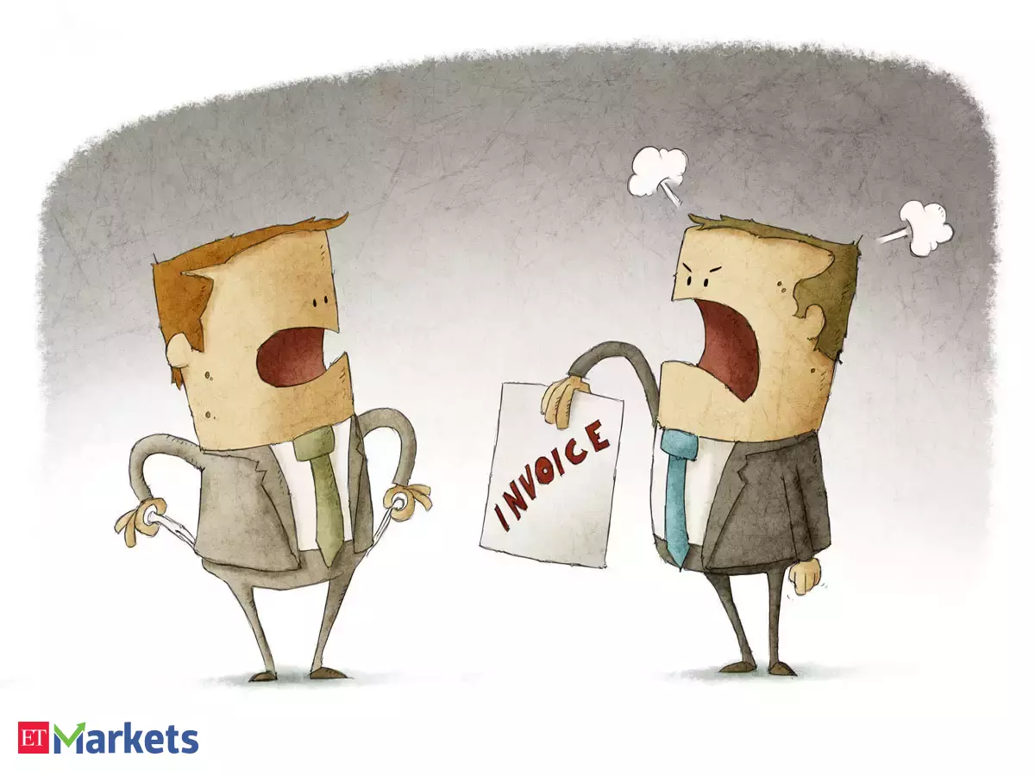
Default Risk

Slide 3
Input briefing

